Slide 1
Online Restaurant MANAGEMENT System
PRESENTED BY:
Hamid Ur Rehman(20PWCSE1969)
Maaz Habib(20PWCSE1952)

Slide 2
CONTENTS
Introduction
Entity-Relation Diagram
Web Interface

Slide 3
INTRODUCTION
Different type of orders.
Categories
Viewing short and long description for ordering easily.

Slide 4
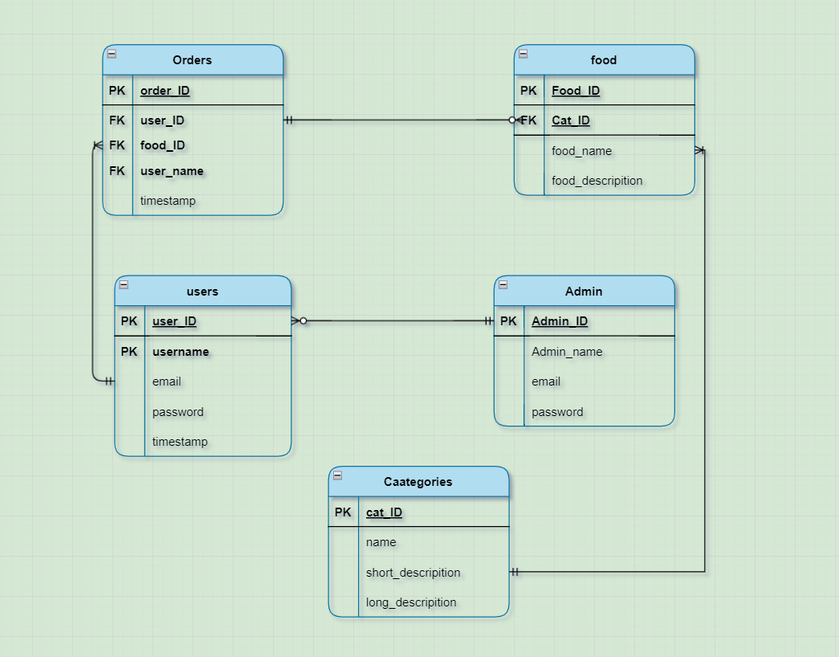
ENTITY RELATION DIAGRAM

Slide 5
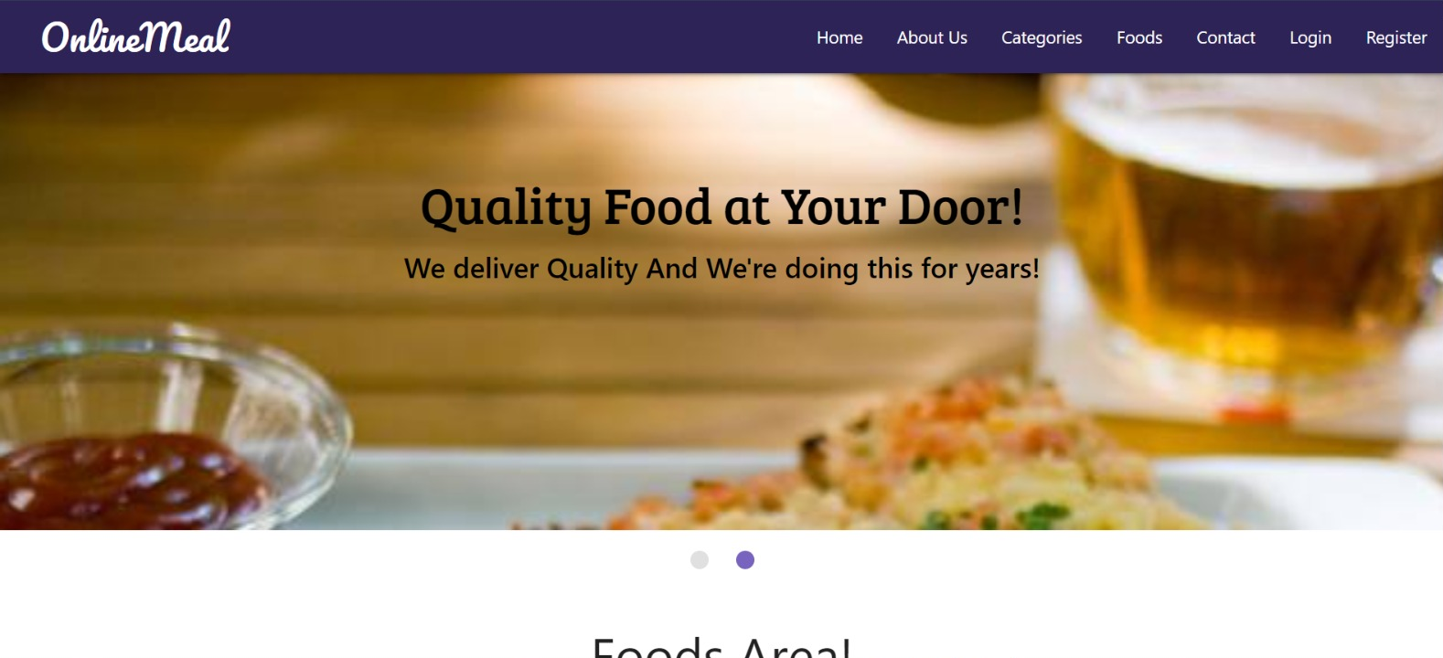
WEB INTERFACE

Slide 6
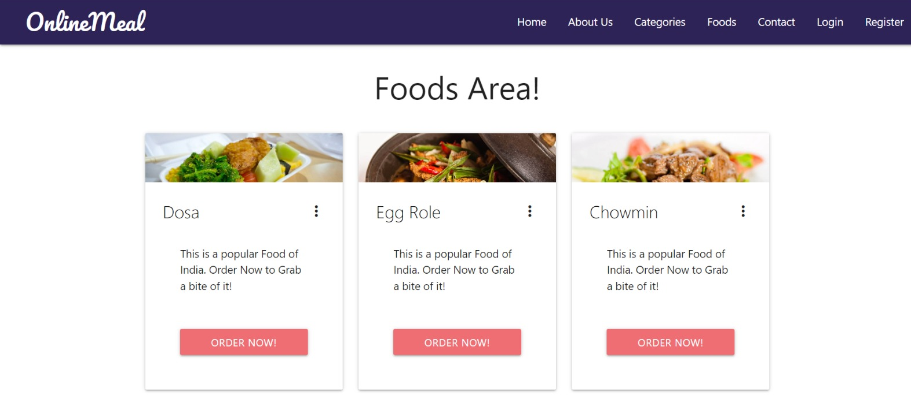
Categories

Slide 7
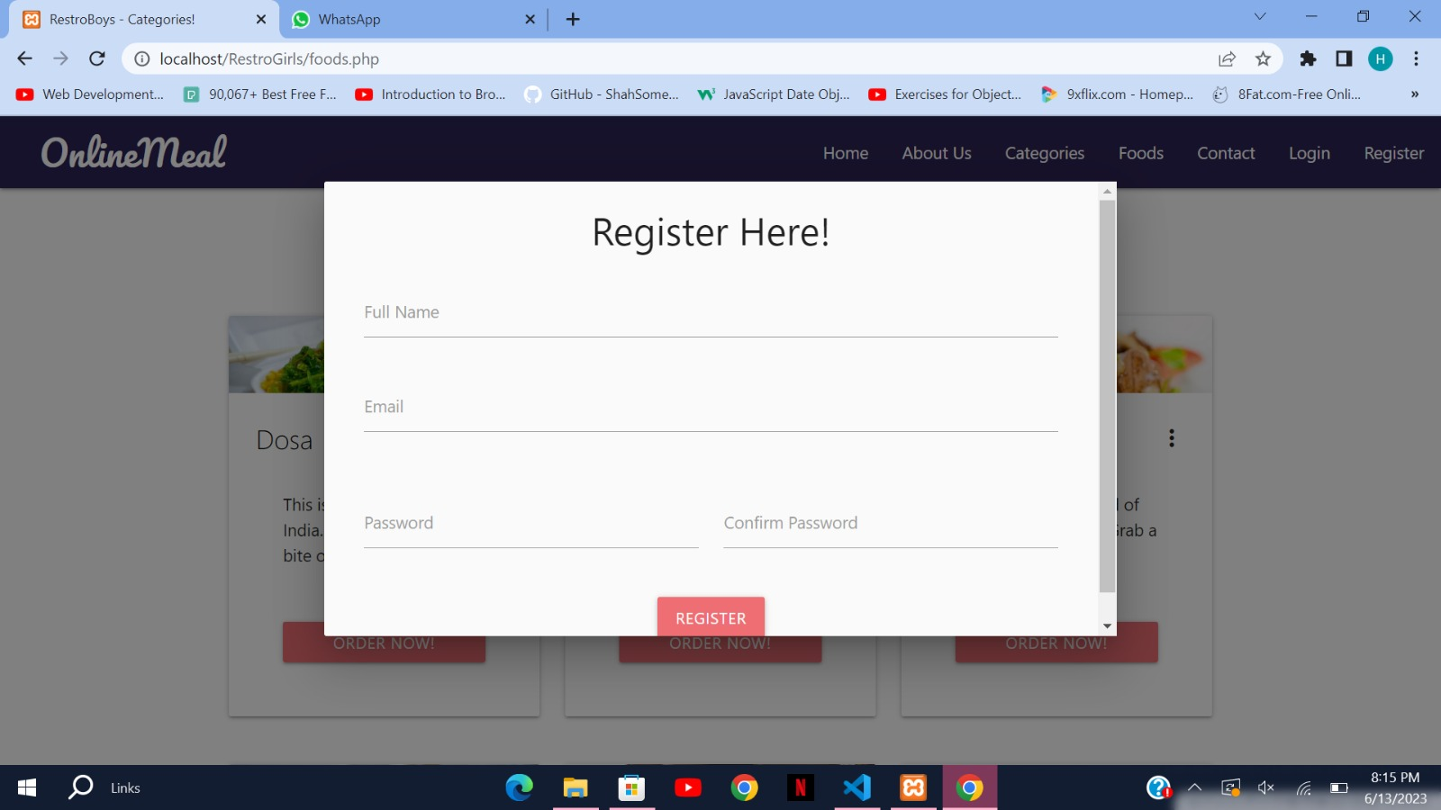
Sign up page

Slide 8
Thank You!

